Slide 1

By Juanita Aguilar, James Hayes, Mei’lani Eyre & Sharief Youssef

Slide 2
User Stories
As an Athlete, I want to be able to capture a video and save it to my video gallery, so that coaches can visually assess my basketball skills.
As a user, I want to be able to register an account, so that I can have a profile to store my basketball videos and game stats, so that coaches can view my basketball skills.
As an Athlete, I want to be able to input my stats after one of my games, so that I can track my career (season) stats, this will help identify which aspects of my game I should focus on improving.

Slide 3
Use Cases
Use Case 1A – Take a video
Precondition – User does not have an account
Description – The user (Athlete) clicks on the add video button. The user is asked for permission for the app to access their camera. The camera app opens up and the user can take a video. When finished, the user can view the video or go back to the gallery page where they can opt to create an account to save the video.
Postcondition – The captured video is saved in an image store, stored locally in the app.
Exception – The app will display an alert informing the user how the GYBITG app uses the camera and requests permission to do so.

Slide 4
Use Cases Continued...
Use Case 2 - Account Creation (Registration)
Precondition - User enters their email address, password and password confirmation.
Description - The user navigates to the registration page via a link from the login page, or is redirected to the registration page after trying to save a video or stat entry. After entering their email address, password, first and last name, high school name, club team/AAU team, graduation year, and state, the user presses ‘create account’. After verification on input field requirements, the user entity will be saved in the database.
Postcondition - The user shall be able to sign-in to their account from the login page using their email and password.
Exception - The user does not enter a valid email address or the password and confirmation password do not match, an alert warning the user about the non-valid email or non-matching password error shall be displayed. A user must also enter a first name, last name, high school name, club team/AAU team, graduation year, and state. If any of these fields are empty, then an error exception is presented to the user.

Slide 5
Use Cases Continued...
Use Case 3A - New Stat entry with Account
Precondition - User has a athlete membership, is signed-in, and knows their stats from previous game(s).
Description - The user enters their stats in the stat form text boxes, then presses the ‘save’ button. The user is redirected to their profile page with a confirmation that the new stat entry was added.
Postcondition - The user’s profile will now have an updated version of their career stats based off the new game stats. The stat entry will be saved in the database.
Exception - The user does not fill out the form or leaves a textbox blank, a dialog box confirms that the user left a textbox blank, an empty textbox will equate to ‘0’ for that stat.

Slide 6
Use Cases Continued...
Use Case 3B - New Stat entry without Account
Precondition - User knows their stats from previous game(s).
Description - The user enters their stats in the stat form text boxes, then presses the ‘save’ button. The user is prompted that they must sign-in or register a athlete membership to save stats. The user is redirected to the sign-in view or register account view, depending on their selection. After signing-in or registering an account their stat will be saved to the database, and the user will be redirected to their profile.
Postcondition - The user will either be signed-in or have a new athlete membership. The user’s profile will have an updated version of their career stats.
Exception - The user does not fill out the form or leaves a textbox blank, a dialog box confirms that the user left a textbox blank, an empty textbox will equate to ‘0’ for that stat. The user does not sign-in or register an athlete membership when prompted to, the user is redirected to the landing page.

Slide 7
Most Viable Product (MVP)
The MVP will allow the user to record and save a video, create an account, and add a new game stat entry.
What are you trying to learn with this particular MVP? Does the app flow make sense to the user or does it make it more confusing?
What data are you collecting? Does the user actually create an account once he/she has recorded a video?
How will we use what we learn? To either keep the design or redesign the landing page.

Slide 8
App Demo

Slide 9
Where We Are Now - MVP Progress
Record and Save a Video - The user is now able to either take a video and it will be saved to their video library or select an existing video from their library. A thumbnail of the videos will be created and added to the gallery tableview.
Account Creation - The user can now begin creating his/her account by filling out the New Account form. Supported input parameters include Email, Password, First and Last name, High School Name, Club Team/AAU Team, Graduation Year, and State. These fields are verified when submitted.
Game Stat Entry - Currently the user is able to view all their stats, save and edit a stat entry with the properties: game date, points, rebounds, assists, steals, blocks, minutes played, opposing team name, and home/away game.

Slide 10
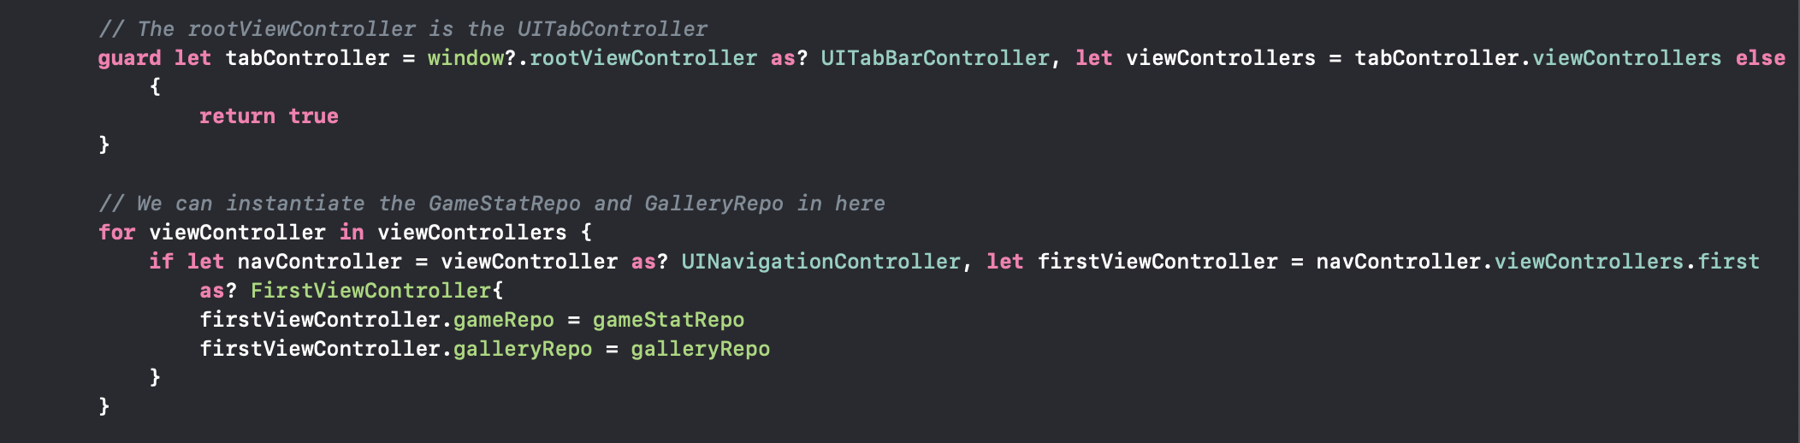
Struggles and Challenges
Instantiating our repositories in the AppDelegate file...

Slide 11
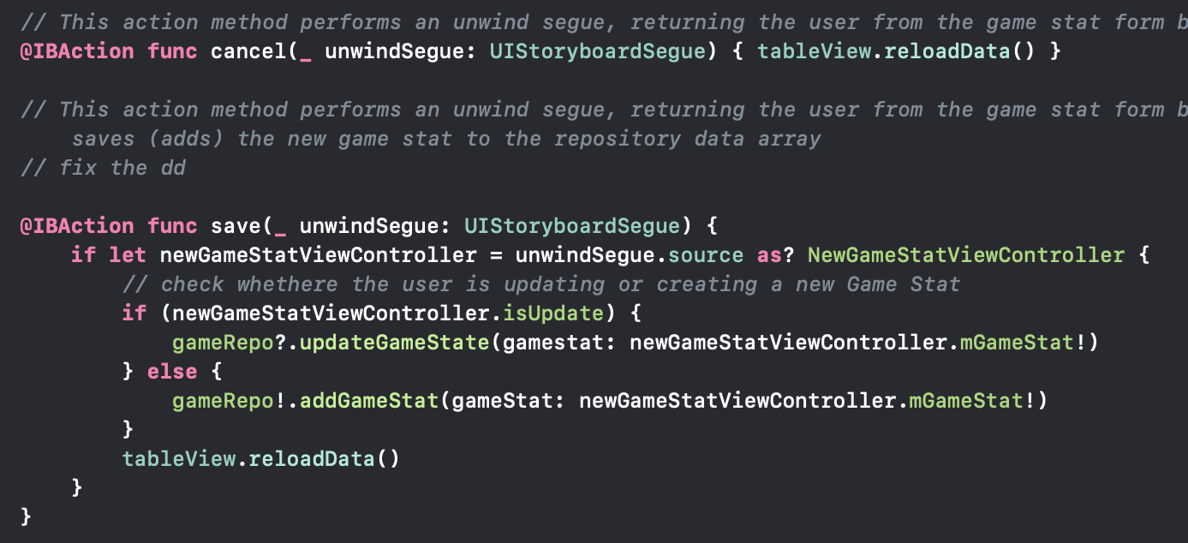
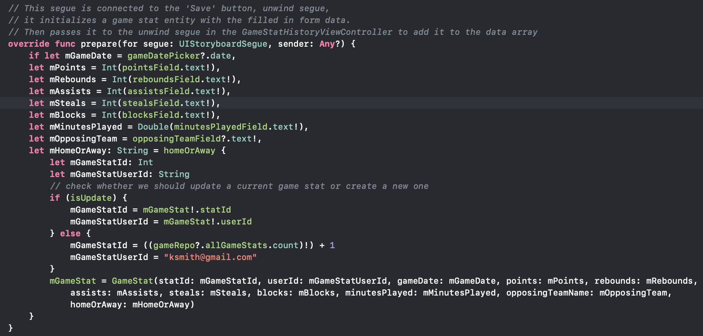
Struggles and Challenges Continued...
Figuring out how to use the unwind segue to pass data backwards...

Slide 12
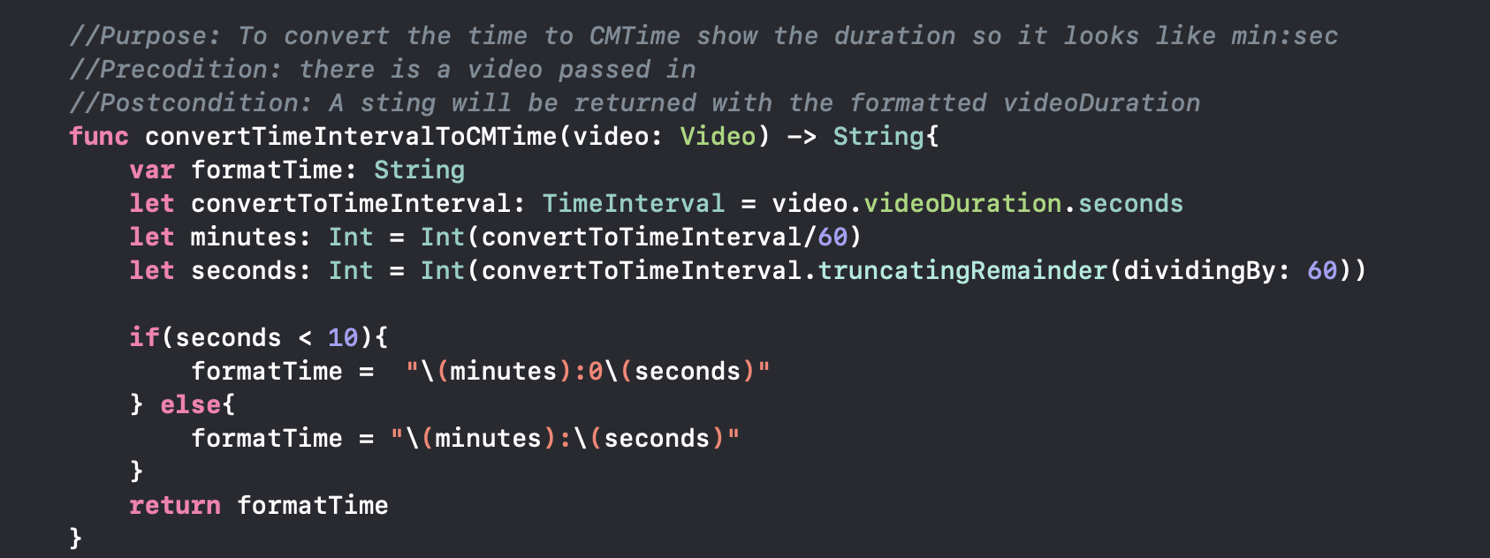
Struggles and Challenges Continued...
How to make the video duration into a particular format

Slide 13
What’s Next?
Setup a persistent data storage (on the Cloud?)
Securely authenticate a user at login
Refactor the GUI implementation from Storyboard to SwiftUI
Create a profile view to display and manage user’s data
Create a video editing feature e.g. Delete, Description
Video upload from outside sites e.g.YouTube

Slide 14
Thank You

